Slide 1
Just do context can make it look better in powerpoint
problems

Slide 2
Predicting athletic performance

Slide 3
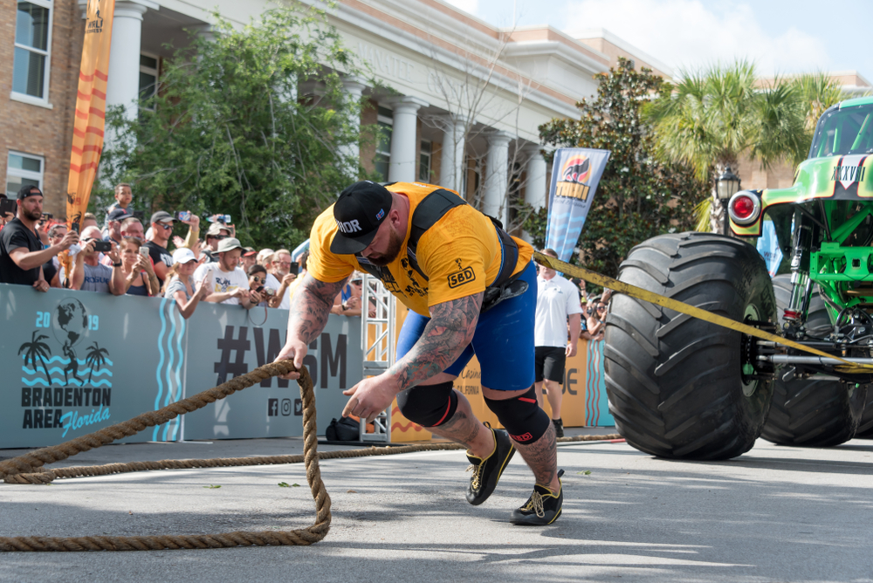
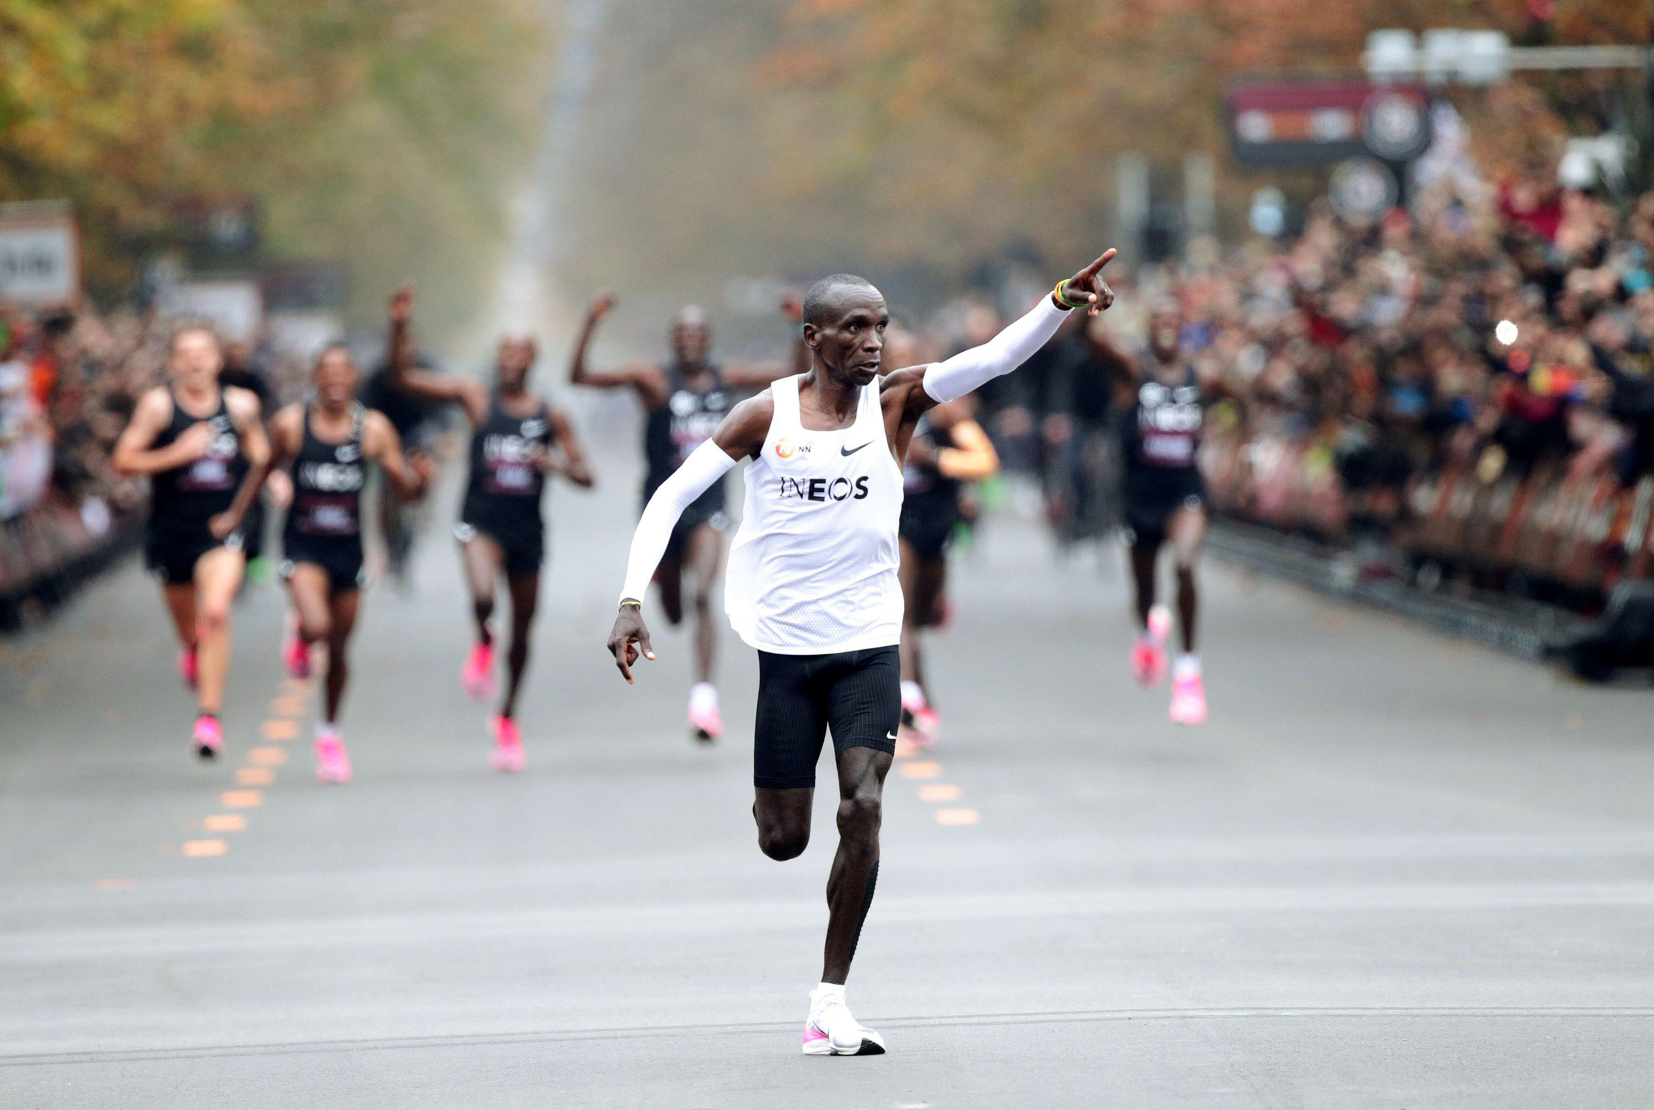
Not all athletes are the same

Slide 4
What is performance?
How well we use energy
How much energy with have? What does this mean:
  Energy capacity – total amount of energy in the reservoir
  Energy output – how much can be exerted at once
  Stamina – efficency, how long can it be sustained

Slide 5
3 Minute test

Slide 6
Critical power

Slide 7
W Prime

Slide 8
What I am trying to solve
Real time monitoring

Slide 9
Aims
Minimal amount of time data
High accuracy
No one wants to do the 3mt test

Slide 10
The dataset

Slide 11
Experimental design

Slide 12
Results

Slide 13
Next steps
Neural networks – wider dataset
Clustering dataset

Slide 14
Conclusions

